Slide 1
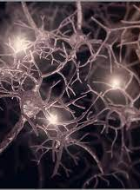
Lifespan Psychology: Adolescent neuroplasticity
AEPSY Year 11 ATAR

Slide 2
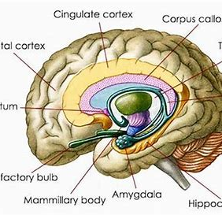
Review
Describe the function(s) of the following parts of the brain
a) frontal lobe
b) corpus callosum
c) amygdala
d) cerebellum

Slide 3


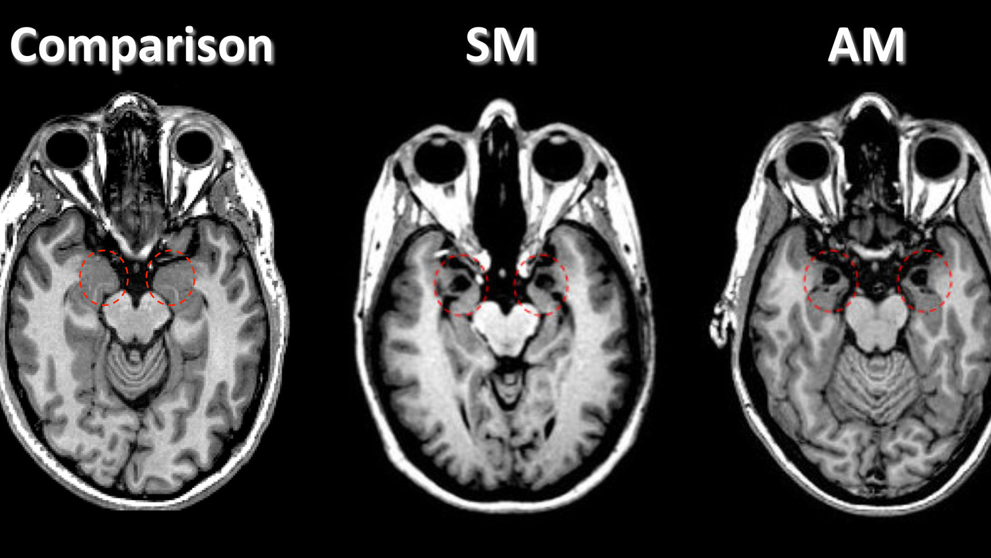
Review
2. Briefly describe the following case studies – which part of the brain was involved, and what observations lead to our understanding of the function of those structures.
Phineas Gage
Sperry’s Split Brain Experiments
Patient “S.M.”

Slide 4
Review
3. List the stages of brain plasticity in infants.
P
M
C
S
M

Slide 5
Learning Intentions
role of brain plasticity in adolescent development
adolescence
effect of changes in brain structures on behaviour and emotion – cerebellum, amygdala, corpus callosum, frontal lobe
effect of changes in frontal lobe development on behaviour and emotion – pre-frontal cortex

Slide 6
Success Criteria
Define neuroplasticity
State the function of the cerebellum, amygdala, corpus callosum, frontal lobe and prefrontal cortex.
Describe the changes that occur in the adolescent brain to each of the above.

Slide 7
Brain plasticity
‘plastic’ = mouldable
Brain plasticity is the ability of neural connections to grow and reorganise.

Slide 8
Neuroplasticity in adolescents
Circuit formation continues until early adolescence, when the volume of grey matter is at its maximum.
Synaptic pruning continues into early adulthood, progressing from the back to the front of the brain (prefrontal cortex last).
Myelination of remaining neural connections occurs into 20s.

Slide 9

Jigsaw cooperative learning
Phase 1: Expert groups (10 min)
Phase 2: Colour groups (15 min)
Phase 3: Questions (10 min)

Slide 10
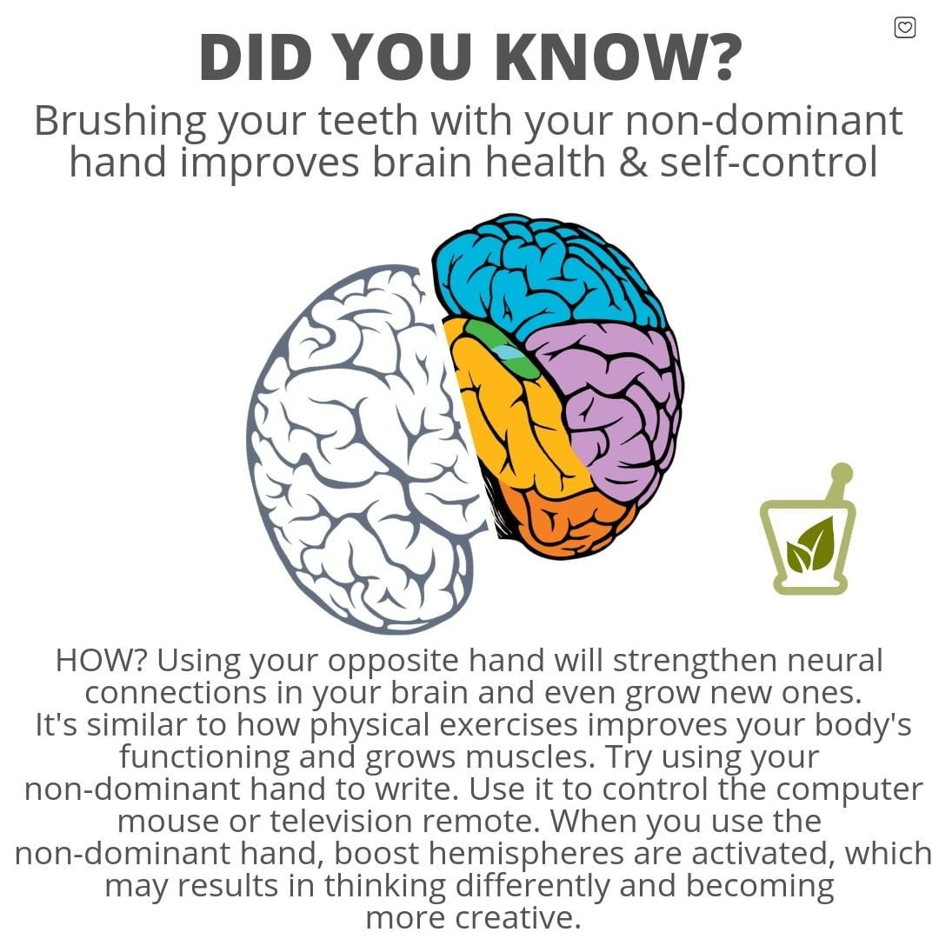

Slide 11
Success Criteria
Define neuroplasticity
Distinguish between developmental and adaptive neuroplasticity, giving examples.
Come up with an acronym for stages of plasticity during infancy
Define and draw a diagram to represent each stage

